Slide 1

A Brief Introduction to O-RAN and xApps
Dr Philip Rodgers
SANS 2024

Slide 2

Who Am I?
Abridged history …
BSc (hons) in Computer Science
Worked in industry as a software engineer
Got a PhD in Artificial Intelligence
Teacher/Lecturer at Strathclyde and Caledonian Universities
Moved to industry with Rakuten Mobile
Academic collaborations on Autonomous Networks
… and now back to academia

Slide 3

What Am I Doing?
I am a research associate here at the University of Glasgow
Still in the field of Autonomous Networks
The current goal is to create an App Store for xApps
Funded by EPSRC IAA award EP/X5257161/1
xApps are "cross-layer applications" that (hopefully) make mobile networks run smarter and more efficient
https://xkcd.com/1133

Slide 4
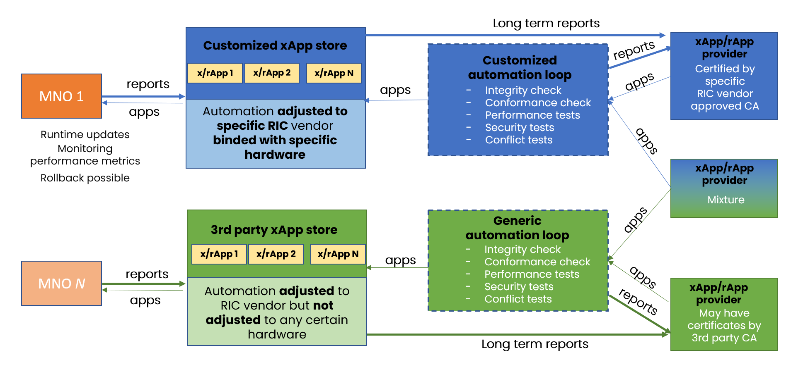
Towards Autonomous Open Radio Access Networks
Adrian Kliks, Marcin Dryjanski, Vishnu Ram OV, Leon Wong, Paul Harvey. May, 2023

Slide 5
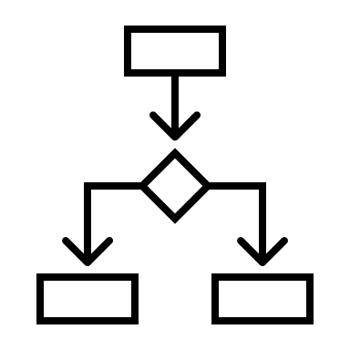
xApps
xApps are intended to implement RAN functions: -
Dynamic optimisation
Closed-loop automation
Service differentiation
Load balancing
Mobility
Energy efficiency
Coverage optimisation

Slide 6
Open RAN
Open Radio Access Network
A paradigm shift in the telecommunications industry
Away from single-vendor, monolithic solutions
To multi-vendor, modular solutions
Open and flexible
Lower barrier to entry and TCO
Scalable
https://xkcd.com/1133

Slide 7
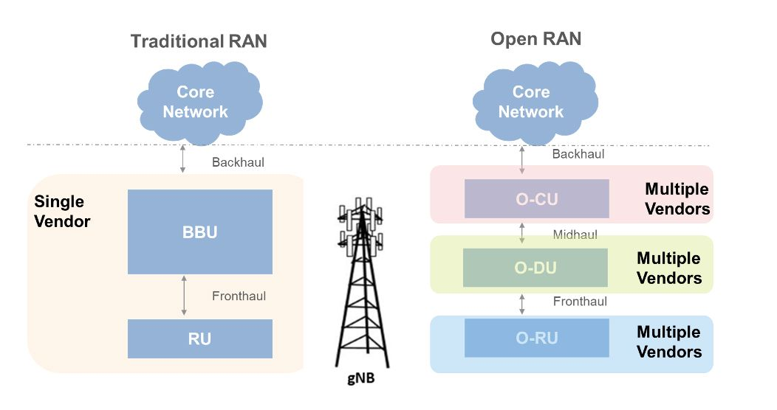
A Quick Comparison
https://uk.mathworks.com/discovery/o-ran.html

Slide 8

Key O-RAN Features
Open Interfaces
Interoperability and Compatibility
Mix and Match components
"Off-the-shelf" components
Virtualisation
Emphasis on software-based solutions running on standard hardware
Software Defined Networks (SDN)
Network Function Virtualisation (NFV)
Cloud-Native Architecture
Micro-services, containers, resource allocation, cost effectiveness

Slide 9

O-RAN Alliance
"O-RAN ALLIANCE is a world-wide community of mobile operators, vendors, and research & academic institutions with the mission to re-shape Radio Access Networks to be more intelligent, open, virtualized and fully interoperable."
https://www.o-ran.org/

Slide 10
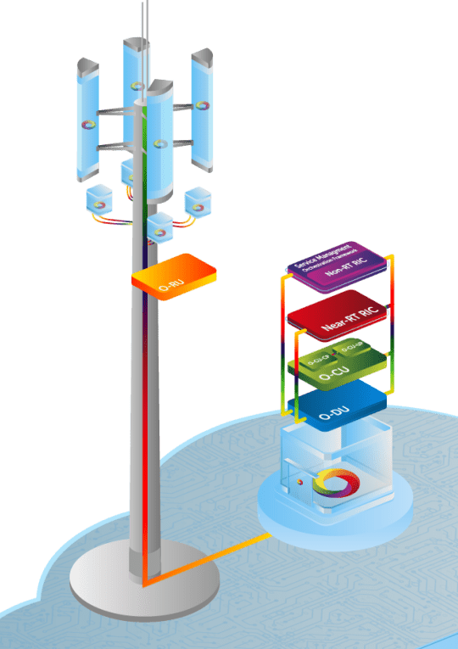
High-level Overview of O-RAN
Radio Unit (O-RU)
Distributed Unit (O-DU)
Centralised Unit (O-CU)
(Near) Real-Time RIC (rtRIC)
This is where xApps live
Non-Real-Time RIC (ntRIC)
This is where rApps live
https://www.o-ran.org/

Slide 11
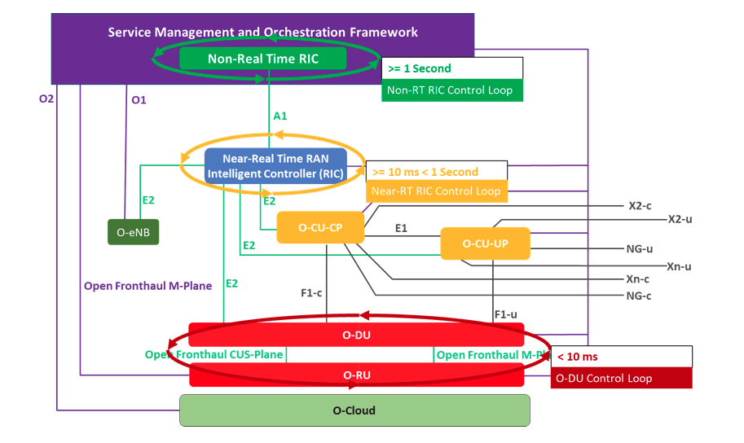
Control Loops and Interfaces of O-RAN
https://www.aspiretechnology.com/blog/open-ran-series-open-ran-intelligence-part-3-of-3/

Slide 12

Building the Testbed

Slide 13
Testbed
OAIC Near-RT RIC

Slide 14
Testbed
OAIC Near-RT RIC
NAMESPACE | NAME | STATUS
ricplt | deployment-ricplt-a1mediator-6ccd8896d7-9zfkp | Running
ricplt | deployment-ricplt-alarmmanager-56d79dc55-phsjg | Running
ricplt | deployment-ricplt-appmgr-6fd6664755-dvjt9 | Running
ricplt | deployment-ricplt-e2mgr-66cdc4d6b6-kvwlj | Running
ricplt | deployment-ricplt-e2term-alpha-db9c45968-524bc | Running
ricplt | deployment-ricplt-jaegeradapter-76ddbf9c9-hhcbw | Running
ricplt | deployment-ricplt-o1mediator-677ff764d7-g7vsr | Running
ricplt | deployment-ricplt-rtmgr-578c64f5cf-l6rrn | Running
ricplt | deployment-ricplt-submgr-7f6499555d-jxh46 | Running
ricplt | deployment-ricplt-vespamgr-84f7d87dfb-6g7kx | Running
ricplt | deployment-ricplt-xapp-onboarder-5958856fc8-7qvk8 | Running
ricplt | r4-infrastructure-kong-646b68bd88-9g7fc | Running
ricplt | r4-infrastructure-prometheus-alertmanager-75dff54776-tff7m | Running
ricplt | r4-infrastructure-prometheus-server-5fd7695-l82mm | Running
ricplt | ricplt-influxdb-meta-0 | Running
ricplt | statefulset-ricplt-dbaas-server-0 | Running
ricxapp | ricxapp-scp-kpimon-7f8f588455-mhrhv | Running

Slide 15
Testbed
OAIC Near-RT RIC

Slide 16

Testbed
OAIC Near-RT RIC
E2
srsRAN
srsUE
srsEPC
gNB

Slide 17
Testbed
xApp
RMR
xApp
OAIC Near-RT RIC
xApp
E2
srsRAN
srsUE
srsEPC
gNB

Slide 18
Testbed
xApp
RMR
RMR
xApp
Pseudo-RIC
*telemetry*
OAIC Near-RT RIC
xApp
E2
srsRAN
Scenario
srsUE
srsEPC
gNB

Slide 19
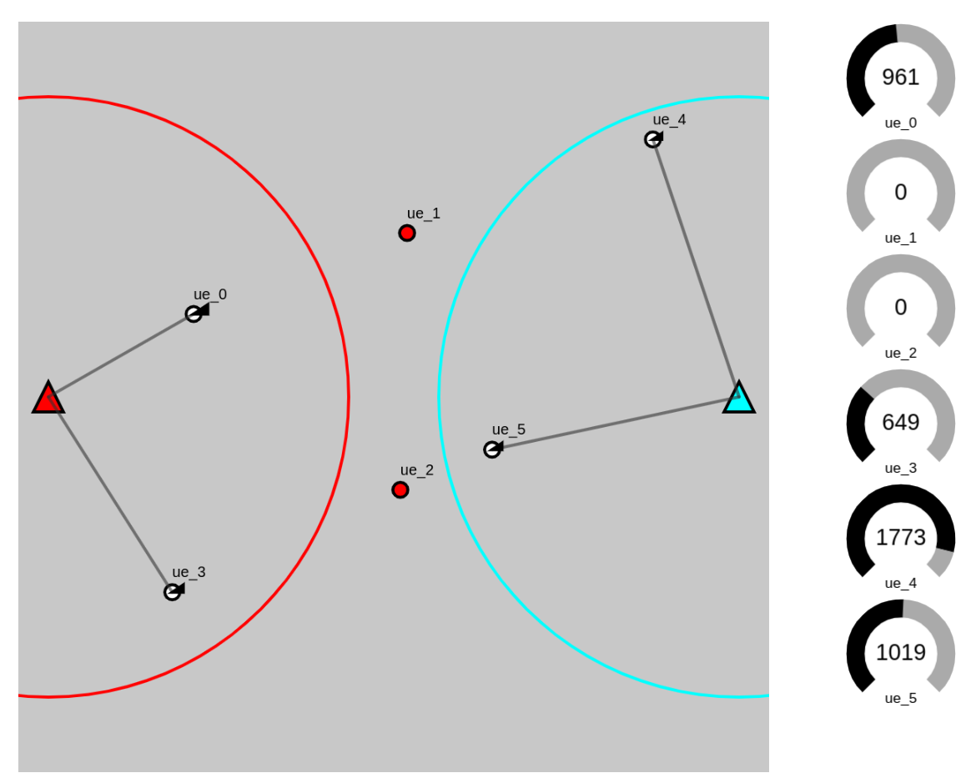
Scenario

Slide 20
xApp Validation
RMR
RMR
xApp
Pseudo-RIC
*telemetry*
OAIC Near-RT RIC
xApp
xApp
E2
xApp
Validation and Testing
srsRAN
Scenario
XML
srsUE
srsEPC
gNB

Slide 21
Conclusions
O-RAN offers a more open and inclusive alternative to vendor-specific solutions
xApps are an important part of an O-RAN solution
xApps afford the ability to introduce intelligence into the network
Bringing us closer to autonomous networks
xApps do not need to be built by telcos
Specialist xApp developers/providers
Provided to telcos via an App Store

Slide 22

philip.rodgers@glasgow.ac.uk

